Slide 1
FACADE Pattern
Facade provides a unified interface to a set of interfaces in a subsystem
it is yet another a very important structural design pattern. Literally speaking the term facade means “outward appearance”.
This pattern involves a single wrapper class which contains a set of members which are required by client. These members access the system on behalf of the facade client and hide the implementation details.
The facade design pattern is particularly used when a system is very complex or difficult to understand because system has a large number of interdependent classes or its source code is unavailable.

Slide 2
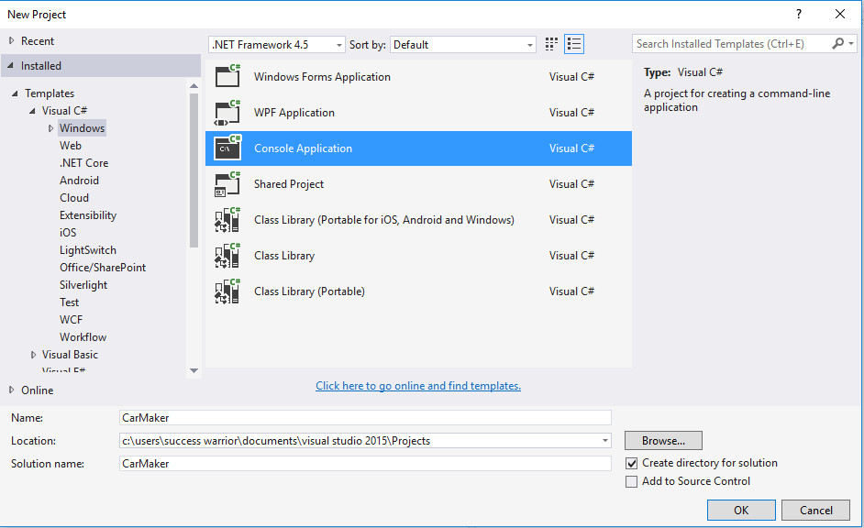

Slide 3
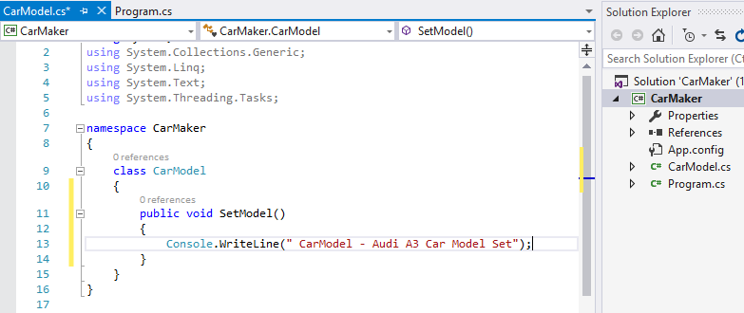

Slide 4
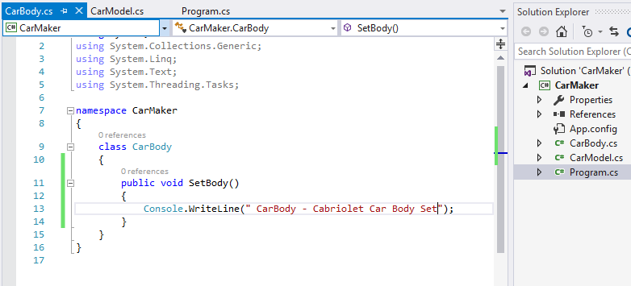

Slide 5
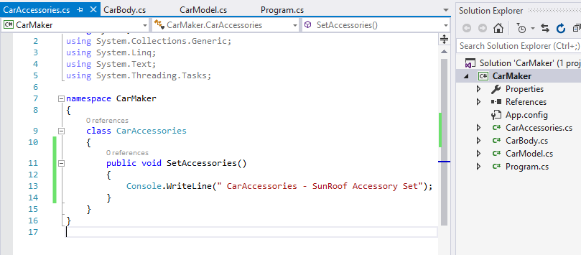

Slide 6
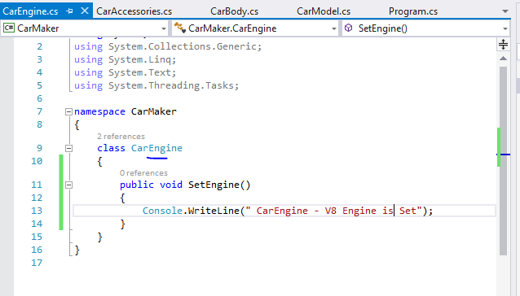

Slide 7
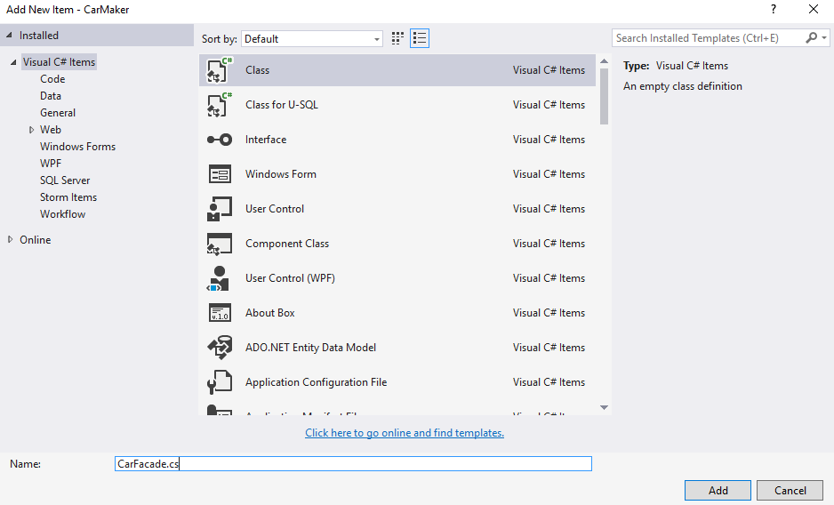

Slide 8
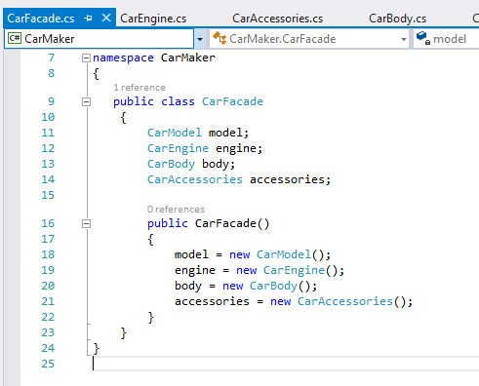

Slide 9
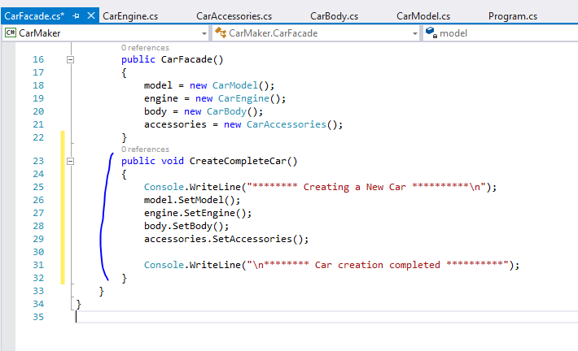

Slide 10
